Slide 1
Estimating Substitution Patterns using text: Evidence from the Film industry
Gideon Moore
October 8, 2024
Third Year Seminar

Slide 2


Which Movie is This?
From the late 2010s
November release
Sequel to movie from earlier in the decade
Stars Kristen Bell
Joint screenwriter/director
Winter theme
Emphasizes the value of family
Runtime of just over 100 minutes
Grossed more than 5x budget

Slide 3
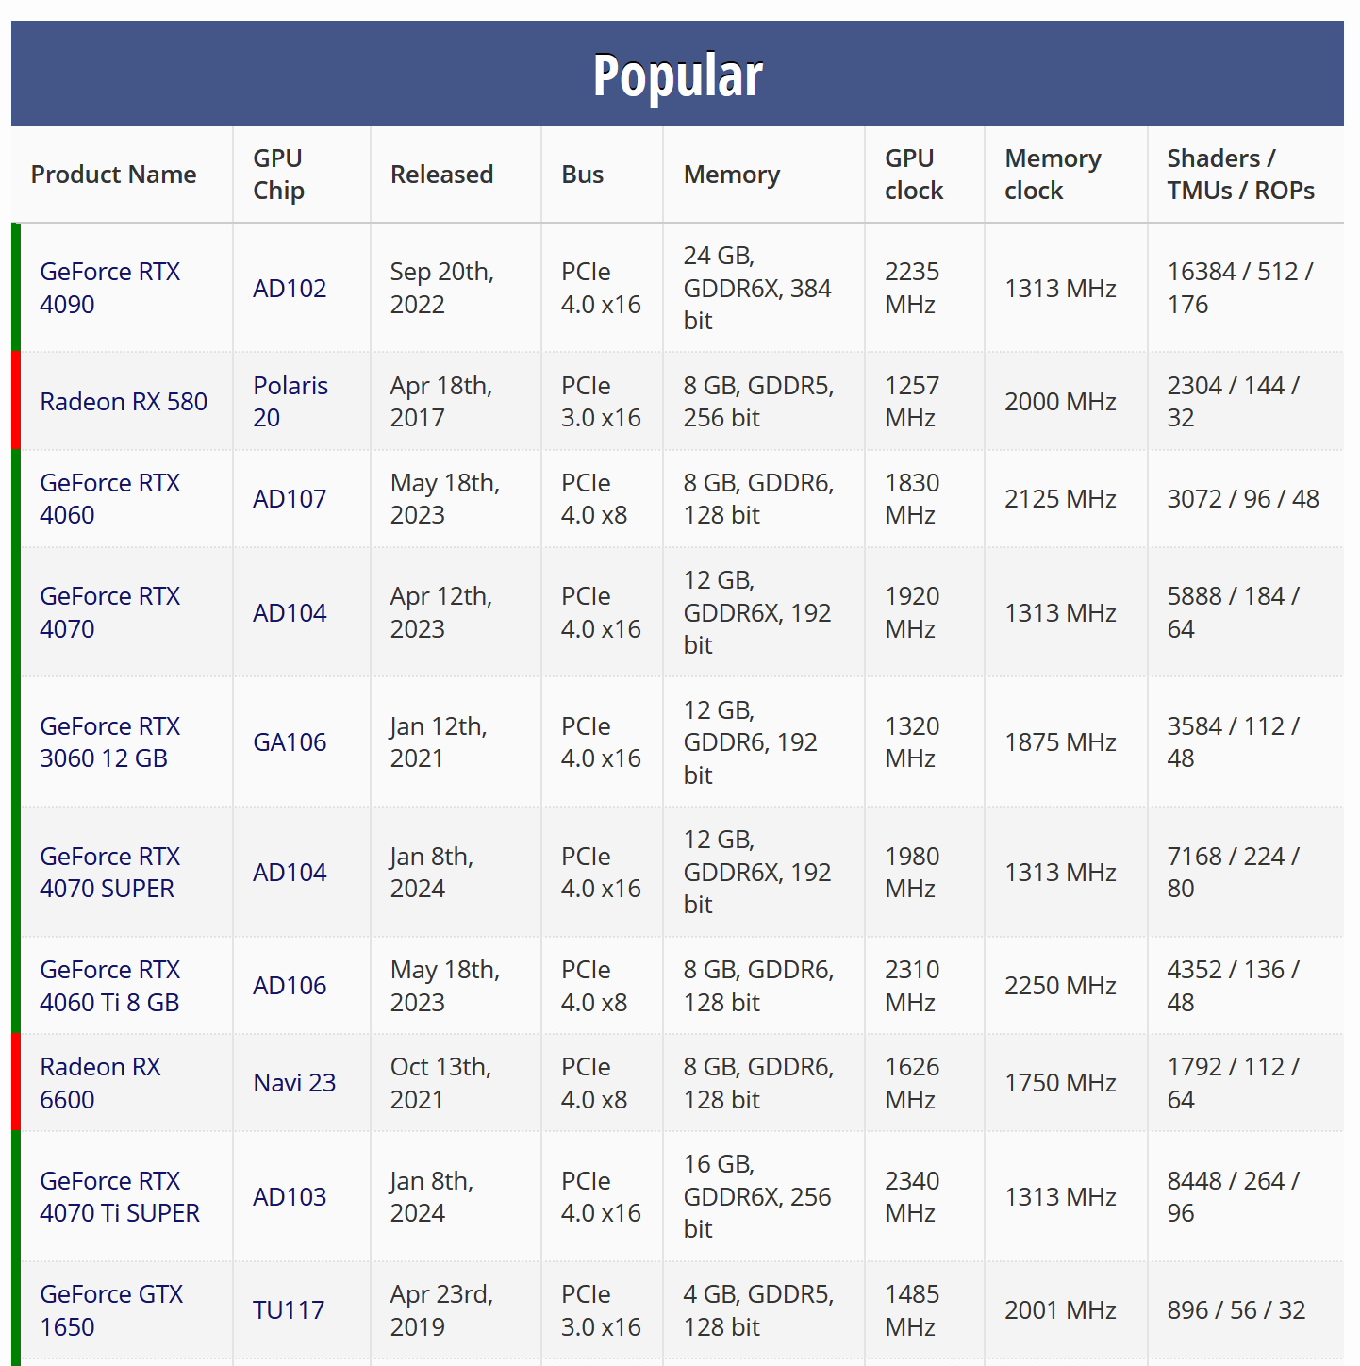
Identifying Good Substitutes is Hard…
Some products have easily-quantifiable characteristics
Computer parts
Energy sources
Grocery staples
Even when attributes are difficult-to-quantify, we “know” when products are similar
No one thinks Frozen II is a close substitute for A Bad Moms Christmas

Slide 4
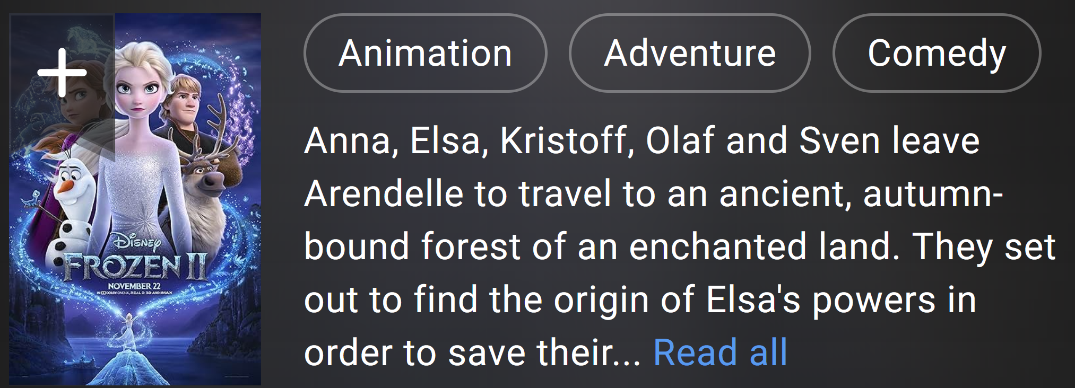
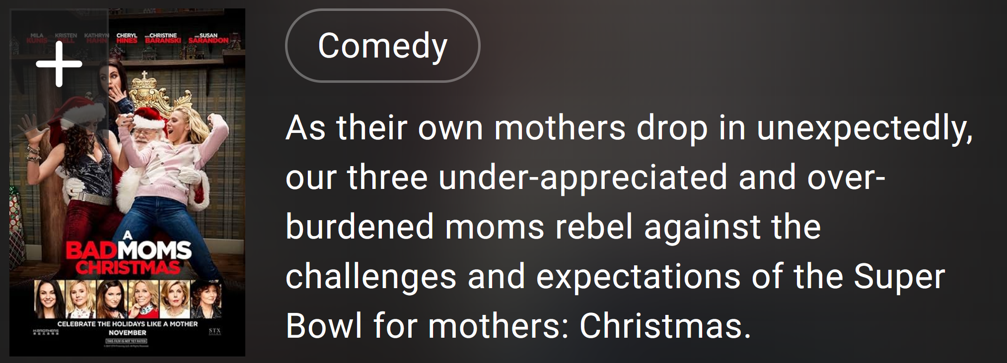
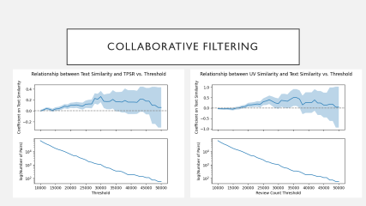

…But Firms Try to Make It Easy
Firms produce descriptions to differentiate their products to consumers
Designed to aid customer decision-making
Using these descriptions, can capture underlying characteristics

Slide 5

The Goal
Use OpenAI text embeddings
API takes in a string of text and provides a vector measuring the content
Projects text into underlying “characteristic space”
Following Magnolfi et al. (2023), can use these embeddings to estimate substitution patterns
Identify substitution based on entry and exit of movies from cinemas

Slide 6
Model & Application

Slide 7
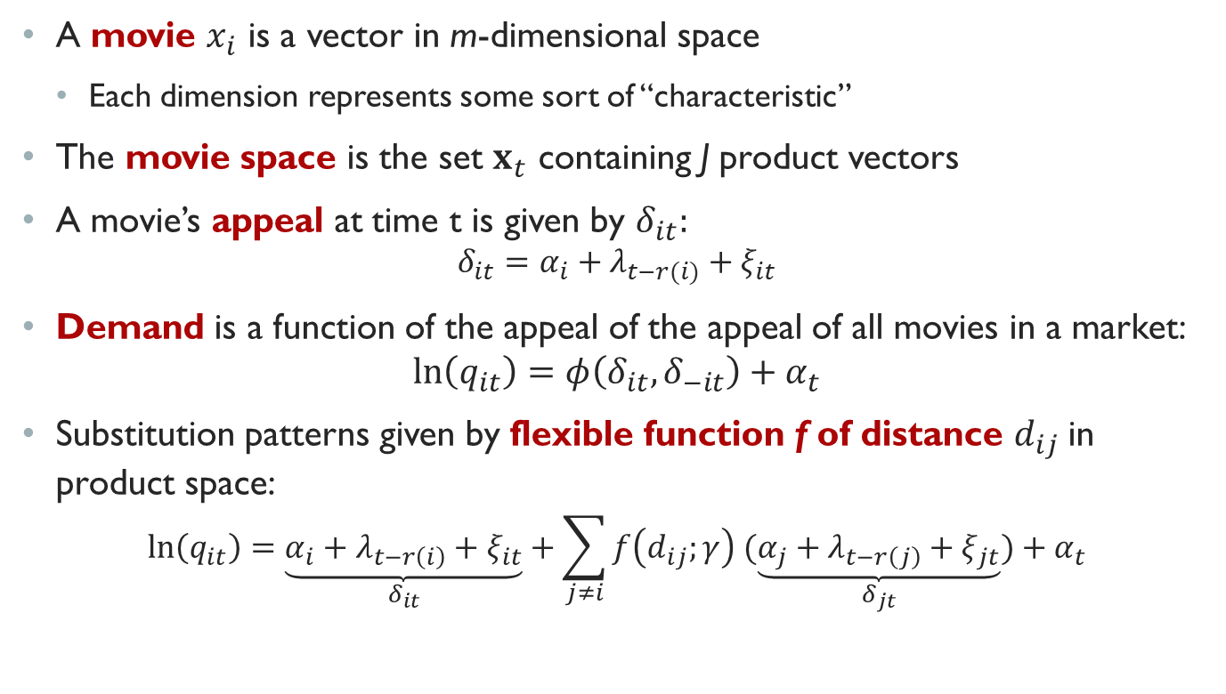
The Model
A movie $x_{i}$ is a vector in m-dimensional space
Each dimension represents some sort of “characteristic”
The movie space is the set $x_{t}$ containing J product vectors
A movie’s appeal at time t is given by $δ_{it}:$
$$δ_{it}=α_{i}+λ_{t−r(i)}+ξ_{it}$$
Demand is a function of the appeal of the appeal of all movies in a market:
$$ln\left(q_{it}\right)=φ\left(δ_{it}, δ_{−it}\right)+α_{t}$$
Substitution patterns given by flexible function f of distance $d_{ij}$in product space:
$$\ln\left(q_{it}\right)=\underset{δ_{it}}{\underbrace{α_{i}+λ_{t−r\left(i\right)}+ξ_{it}}}+\sum_{j≠i}{f\left(d_{ij};γ\right) (\underset{δ_{jt}}{\underbrace{α_{j}+λ_{t−r\left(j\right)}+ξ_{jt}}})}+α_{t}$$

Slide 8
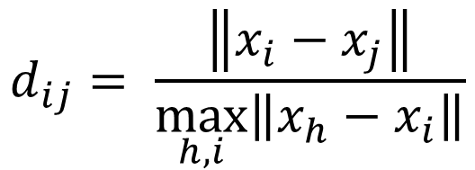
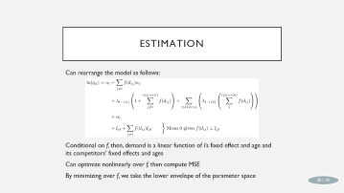

Functional Form
Norm is given by the cosine between the two characteristic vectors
Following Magnolfi, McClure, and Sorensen (2024), use a cubic polynomial
Normalized using largest observed difference
$$f\left(d_{ij};γ\right)=γ_{0}+γ_{1}d_{ij}+γ_{2}d_{ij}^{2}+γ_{3}d_{ij}^{3}$$
$$d_{ij}= \frac{\left\|x_{i}−x_{j}\right\|}{\max_{h, i}\left\|x_{h}−x_{i}\right\|}$$

Slide 9
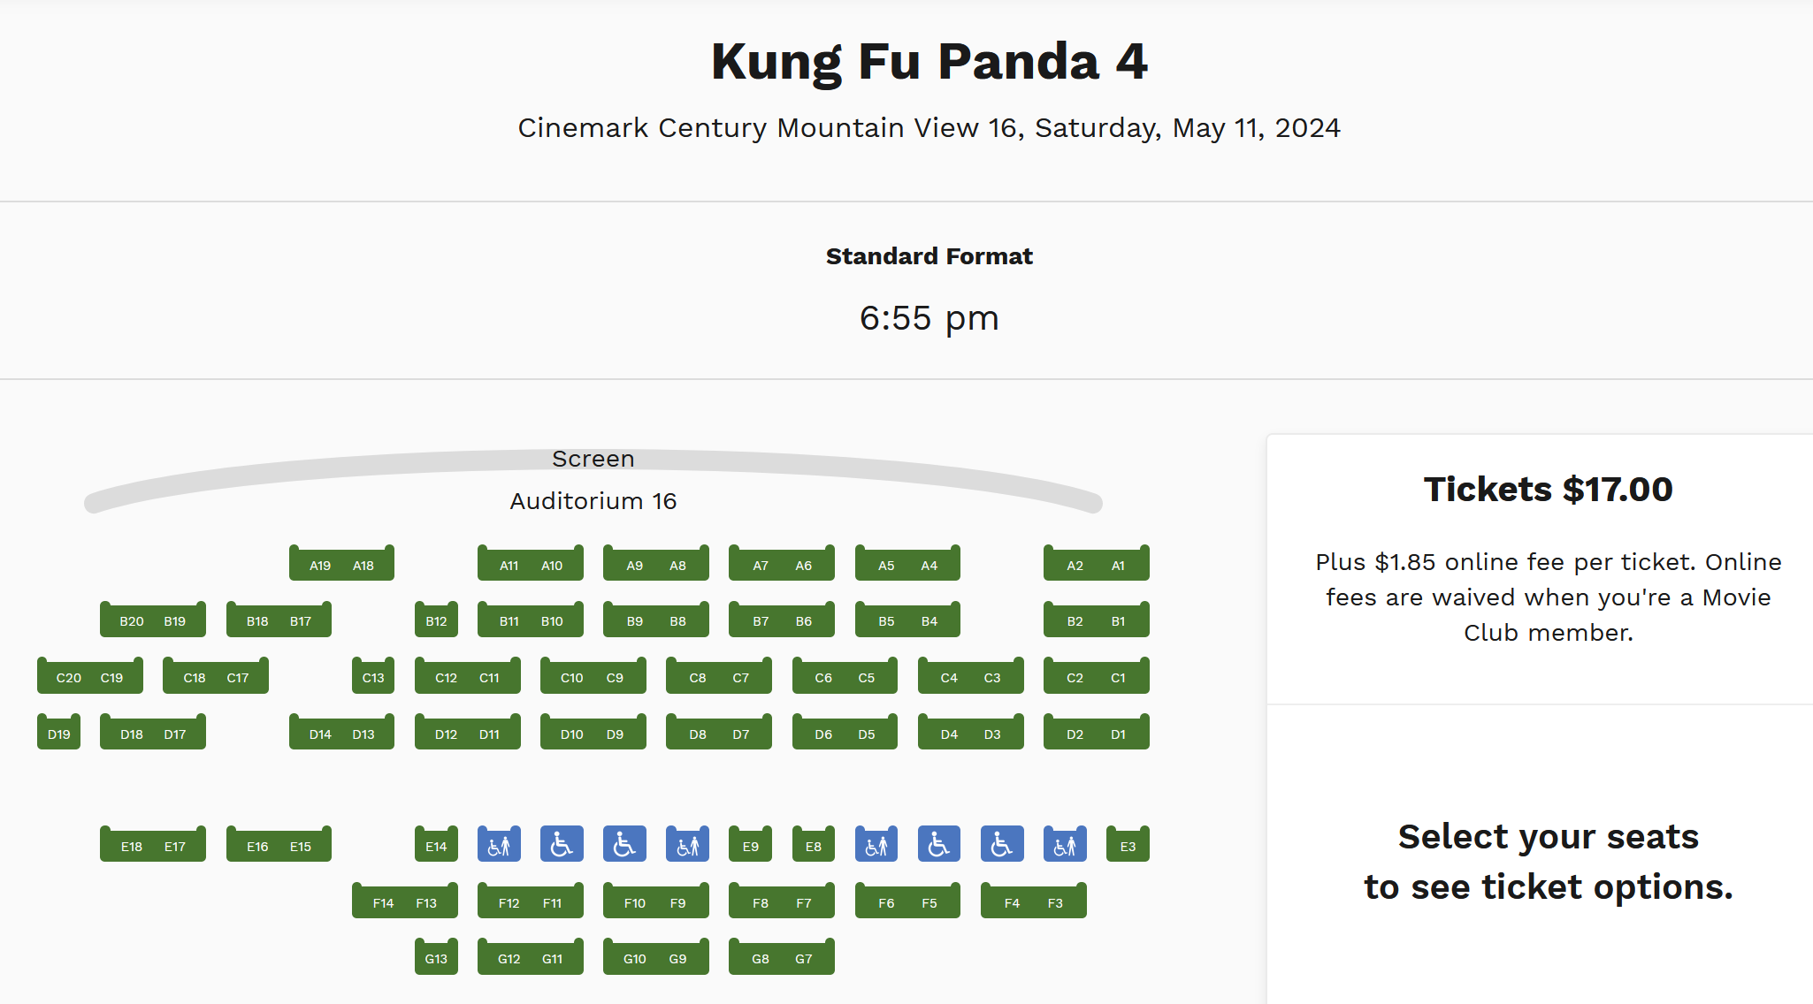
Why Movies: Uniform Pricing Puzzle
Movies have uniform pricing
Can rule out pricing response
Proxy quantity with revenue
Well-documented (though maybe starting to change?)
Orbach and Einav (2007)
Chung (2015)
Ho (2018)
Charging $17 despite having not sold a single seat!
(Movie released 3/8/24, retrieved on 5/11/24)

Slide 10




Why Movies: Exogeneous Characteristics
Within a weekend, I assume characteristics across movies are independent
Otherwise, elasticity confounded with strategic response
This means studios cannot move my movie in time or characteristic space
Twin Films suggest adjustment frictions:
A Bug’s Life / Antz
No Strings Attached / Friends with Benefits
Florence Foster Jenkins / Marguerite

Slide 11
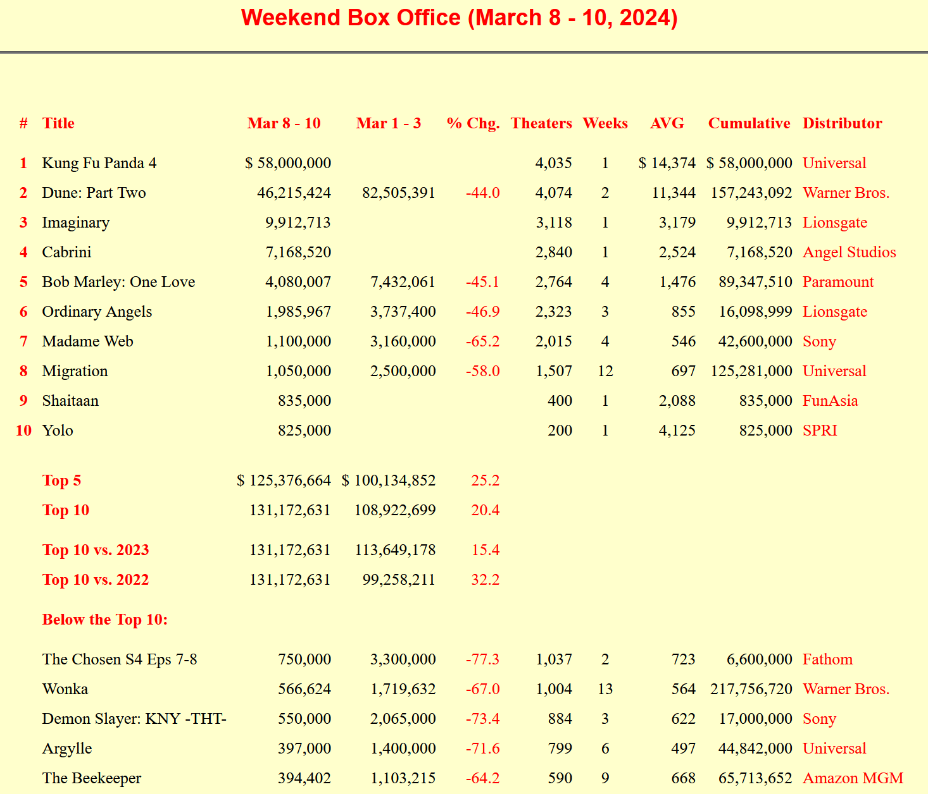
Data
Box office receipts scraped weekly from BoxOfficeGuru
2000-Present
Descriptions pulled from TheMovieDB
Free IMDB Competitor
Using Search API: search for “cleaned” title in year observed in box office data
Embeddings performed using OpenAI

Slide 12
Results

Slide 13
Nearest Neighbors Sanity Checks Cosine Distance
Movie | Nearest Neighbor #1 | Nearest Neighbor #2
Frozen | Frozen II | Mirror Mirror
Dune: Part 1 | Dune: Part 2 | Voyagers
The Notebook | Message in a Bottle | The Longest Ride
Avengers: Endgame | Avengers: Infinity War | Captain America: Civil War
A Bug’s Life | The Ant Bully | Antz

Slide 14
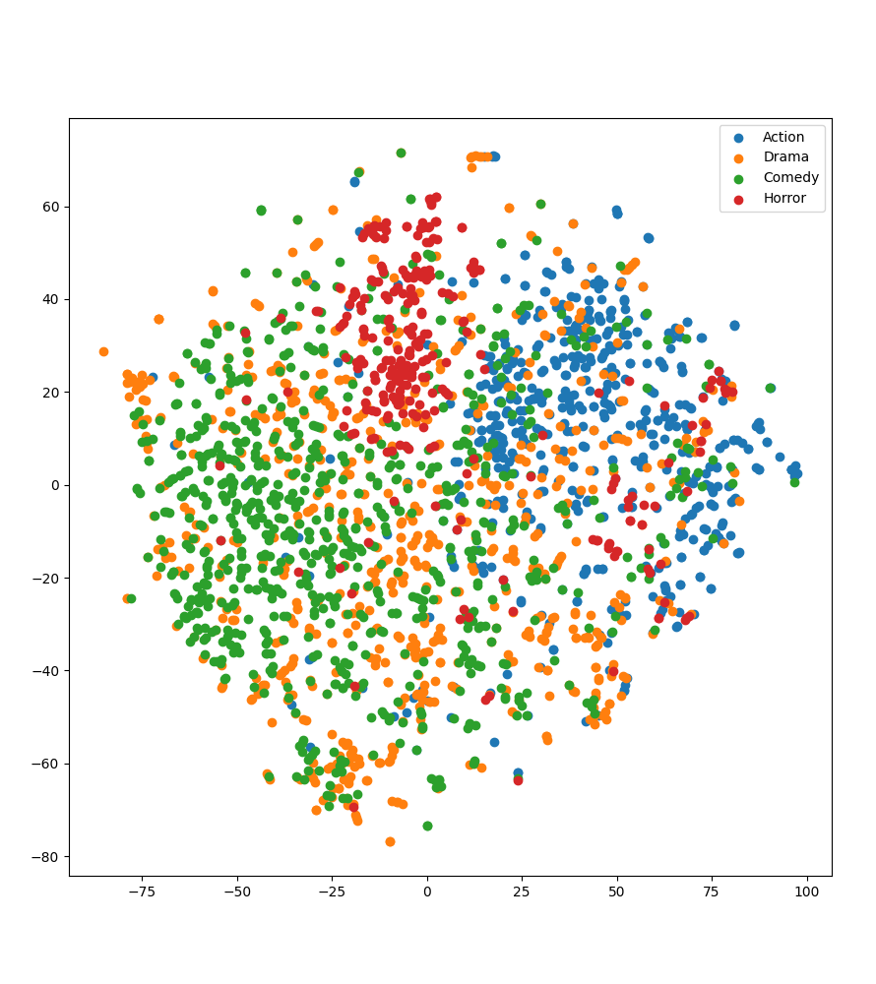
Genre Clustering
Genres taken from TMDB page
If embeddings “work,” similar movies should be close
Run t-SNE clustering on embeddings, reducing to two dimensions
Clusters movies of same genre without training

Slide 15
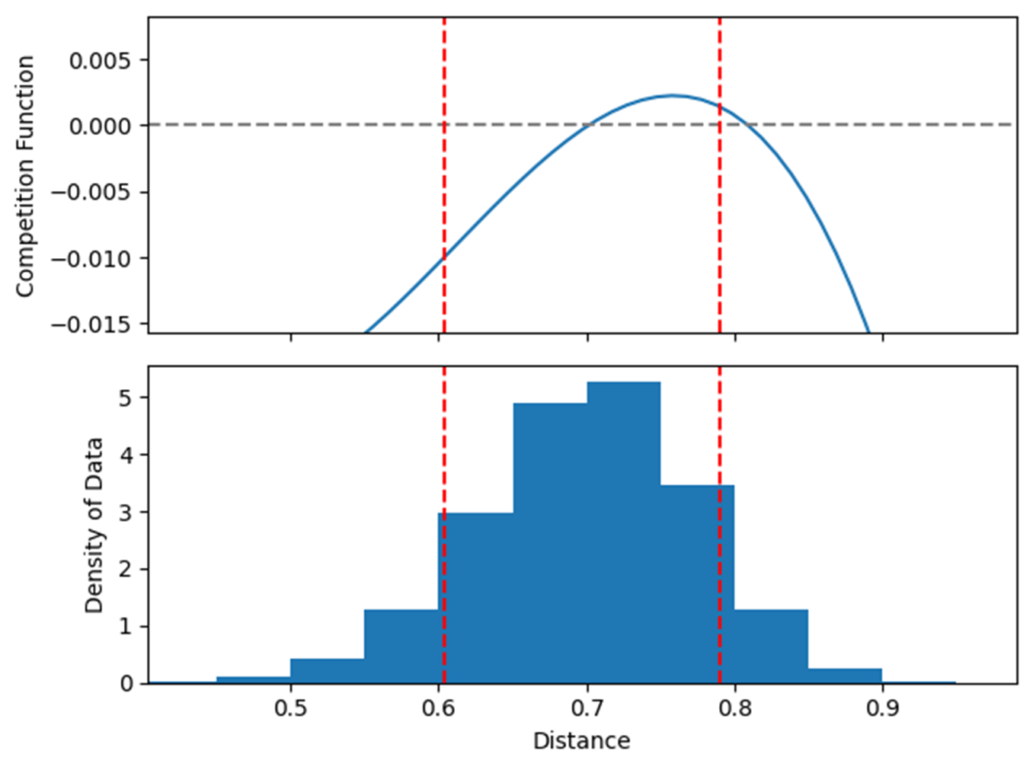


The competition function
After fitting, I get the f function visible at right
Desirable properties:
Negative
Attenuating
(Mostly) Monotone
Concave

Slide 16




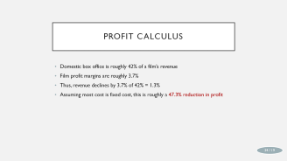
Interpretation: An Example
Disney is launching Frozen this weekend
During the same weekend, Medieval is showing
90th percentile distance from Frozen
Suppose instead we replaced Medieval with Inkheart
10th percentile distance from Frozen
Model suggests 0.033 log-point decline in revenue
47.3% reduction in profit assuming mostly fixed costs

Slide 17
Conclusion

Slide 18
Efficacy of Text Embeddings
Text embeddings produce reasonable (negative, monotone, attenuating, zero-when-distant) substitution patterns while mimicking real decision-maker information
Captures characteristics firm believes are most important using easily available data
Astoundingly cheap: this whole project cost <$0.03

Slide 19
Questions
Do you think the assumptions are realistic? What can I do to sell you on them?
Are there things I should add to the model? Am I missing anything critical?
What's the "next step" here? Do you feel like anything is "missing"?
For the labor people: do we think there's an interesting setting this method could work? I'm thinking something like O*NET descriptions as "worker characteristics"
Similarly for the macro/growth people: do we think there's something to be done with e.g. patent text? I know Maya & Zane have their paper on the "convex cone of knowledge," I wonder if this could be used for something similar. Or maybe measuring firm similarity?

Slide 20
Appendix

Slide 21
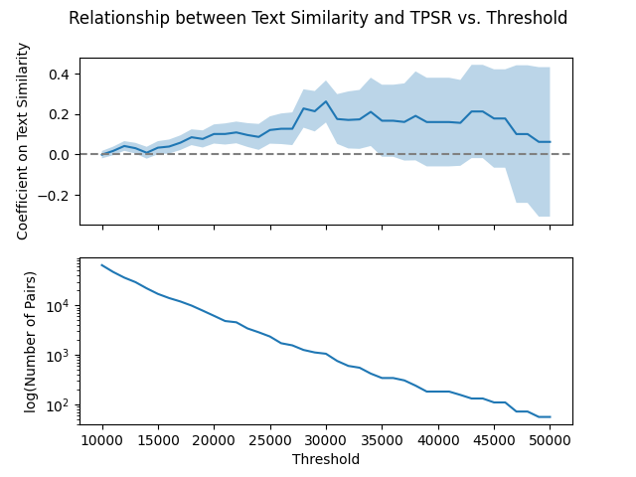
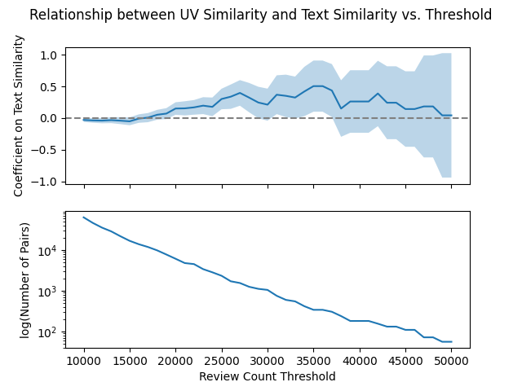
Collaborative Filtering

Slide 22
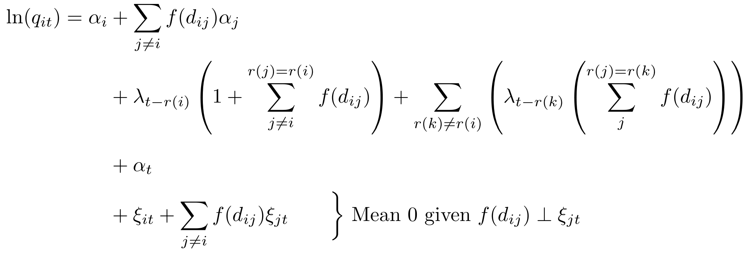
Estimation
Can rearrange the model as follows:
Conditional on f, then, demand is a linear function of i’s fixed effect and age and its competitors’ fixed effects and ages
Can optimize nonlinearly over f, then compute MSE
By minimizing over f, we take the lower envelope of the parameter space

Slide 23

Twin Movie Performance
Studios want to avoid twin films
But, for Giannoli, [Florence Foster Jenkins] was particularly galling, given he’d spent a decade on Marguerite. “I work a lot as a writer to find completely original stories. I don’t want the audience to have the feeling, ‘oh, I saw that!’”
—The Independent, 3/4/2016
Their continued existence suggests characteristics and release windows are inelastic to competition

Slide 24
Profit Calculus
Domestic box office is roughly 42% of a film’s revenue
Film profit margins are roughly 3.7%
Thus, revenue declines by 3.7% of 42% = 1.3%
Assuming most cost is fixed cost, this is roughly a 47.3% reduction in profit

